Slide 1









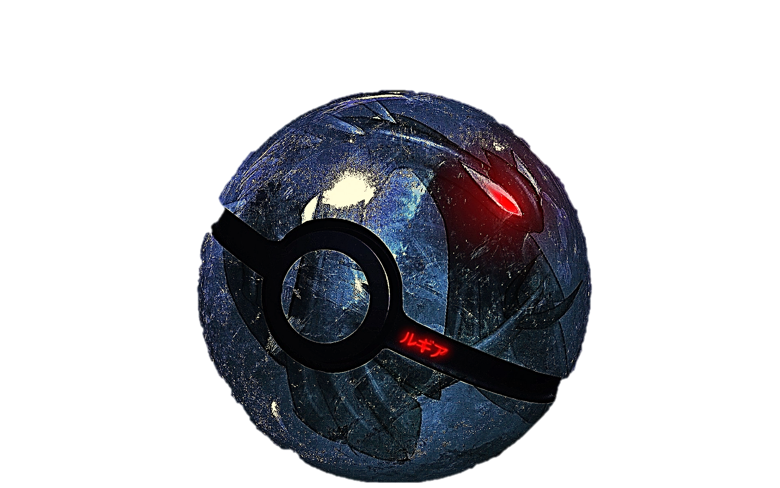
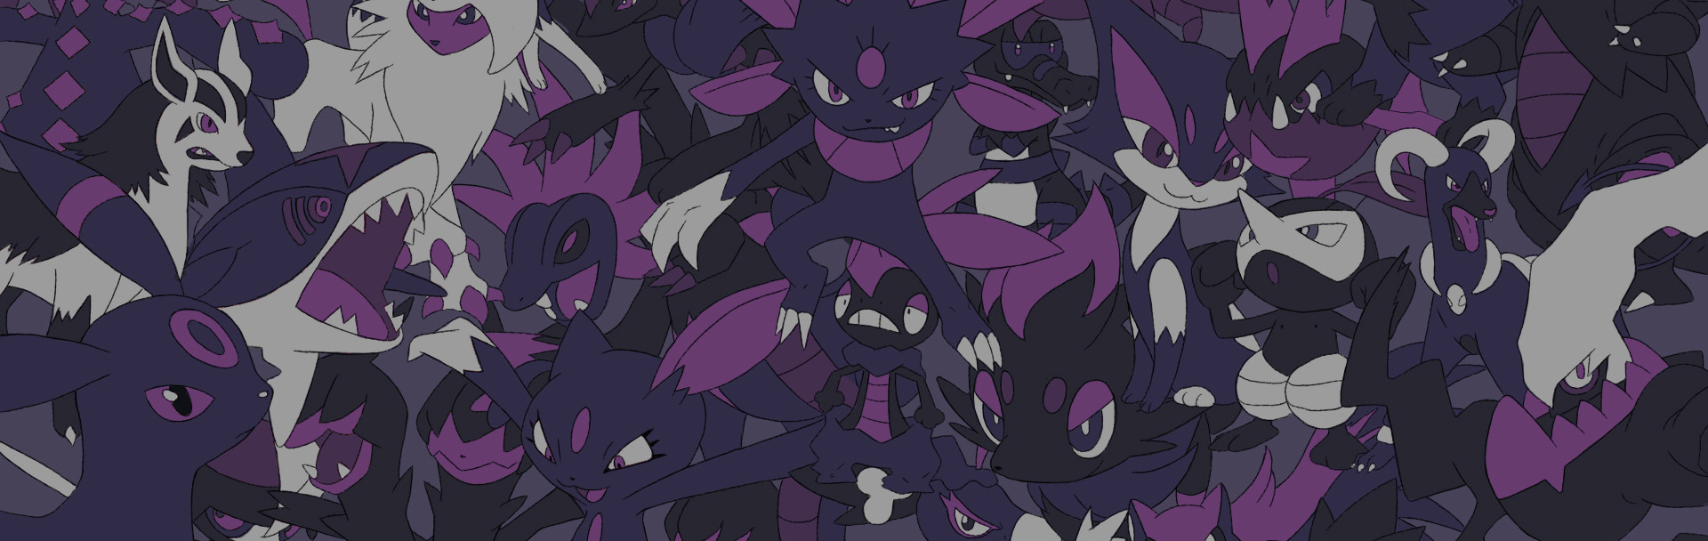

Login / Register
Teams
Collection
Ranks
POKEDEX
Challenges
Click here to view
Pokemon of the Month
Community Highlights
Social Pages
Sort By
TOP SD TEAMS
11 – 03 - 20
Trainer Card
Card Game Sources
SD USER | SD TEAM(S) | GAME(S) | PLATFORM(S) | REGION | APP ID
GLIKCH | GKTM | POKEMON GO! | NTD Switch | USA (NC) | SD348722
-- | -- | -- | -- | -- | --
-- | -- | -- | -- | -- | --
-- | -- | -- | -- | -- | --
Solo Challenges
Shadow Power
GK Shop
GLIKCH DEvelopers
POKE-EXCHANGE
EXP SCRAMBLE
Platform
Game
Register Team !
Region
SDT APP

Slide 2


Shadow
Trainer

Slide 3




TEAMS
COLLECTION
Ranks
Pokedex
---
Community Highlights
Social Pages
Trainer Card
Card Game Sources
Solo Challenges
GK SHOP
GLIKCH DEVELOPERS
Poke-Exchange
Login / Register
Login / Register
TEAMS
COLLECTION
Ranks
Pokedex
---
Community Highlights
Social Pages
Trainer Card
Card Game Sources
Solo Challenges
GK SHOP
GLIKCH DEVELOPERS
Poke-Exchange
Challenges
Click here to view
Pokemon of the Month
Challenges
Click here to view
Pokemon of the Month
SD USER | SD TEAM(S) | GAME(S) | PLATFORM(S) | REGION | APP ID
GLIKCH | GKTM | POKEMON GO! | NTD Switch | USA (NC) | SD348722
-- | -- | -- | -- | -- | --
-- | -- | -- | -- | -- | --
-- | -- | -- | -- | -- | --
EXP SCRAMBLE
SD USER | SD TEAM(S) | GAME(S) | PLATFORM(S) | REGION | APP ID
GLIKCH | GKTM | POKEMON GO! | NTD Switch | USA (NC) | SD348722
-- | -- | -- | -- | -- | --
-- | -- | -- | -- | -- | --
-- | -- | -- | -- | -- | --
EXP SCRAMBLE
Portable Menu
onClick=“{this.dropdown}”;
Dropdown Appear Function
SD APP V 1.01
SD APP V 1.01
Platform
Game
Platform
Game
Region
SDT APP
Register Team !
Region
SDT APP
Register Team !

Slide 4
